Slide 1
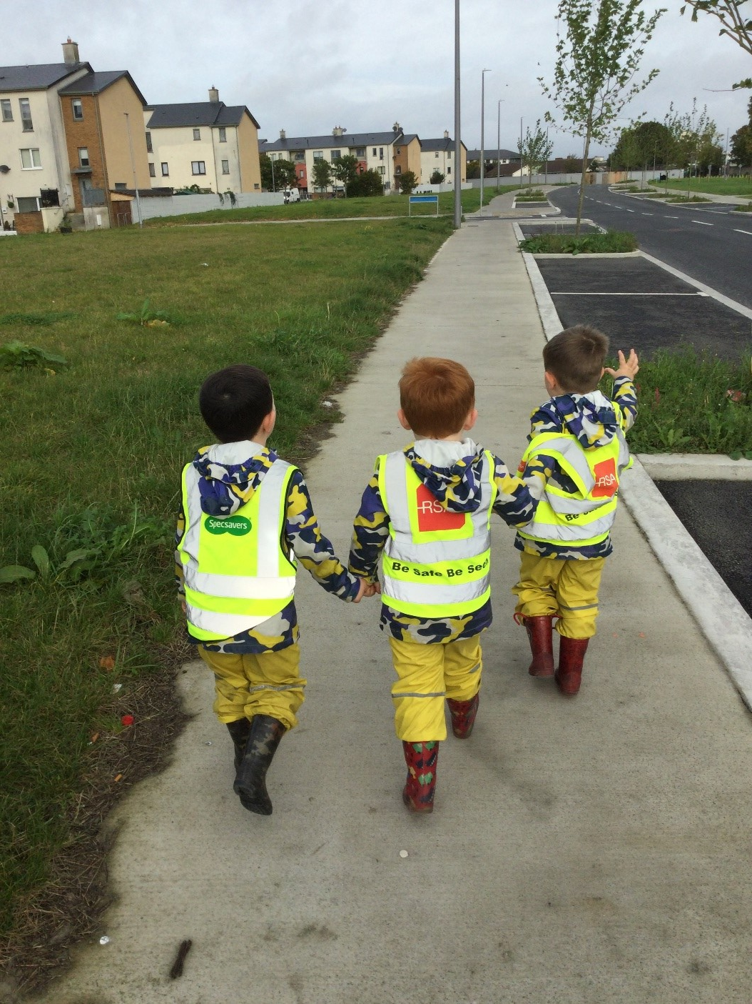

Strategic Plan 2024-2029

Slide 2
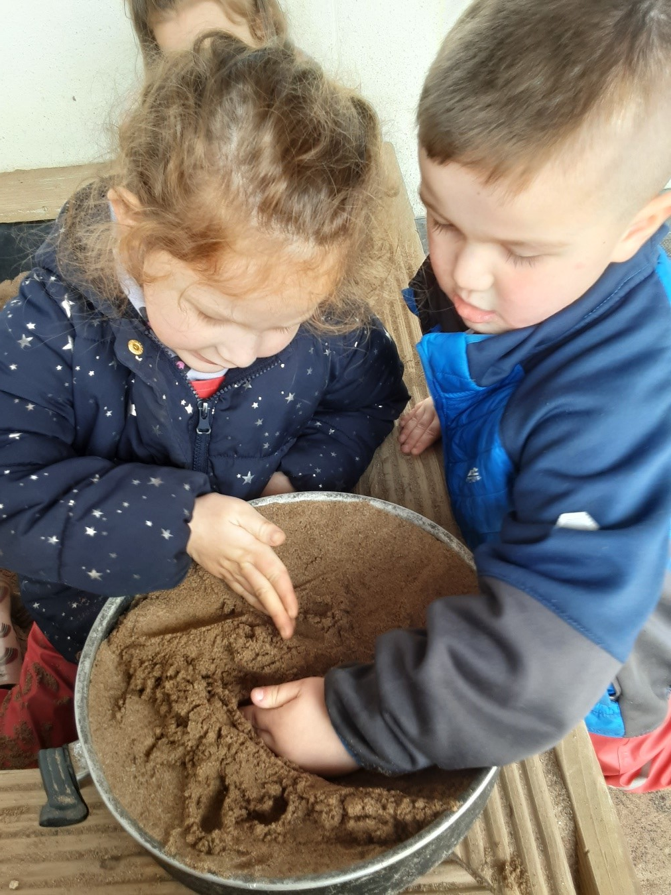
Contents
Introduction
Process
Vision and Mission
Values
Overview of strategic plan
Strategic Goals
Implementation and Measurement

Slide 3
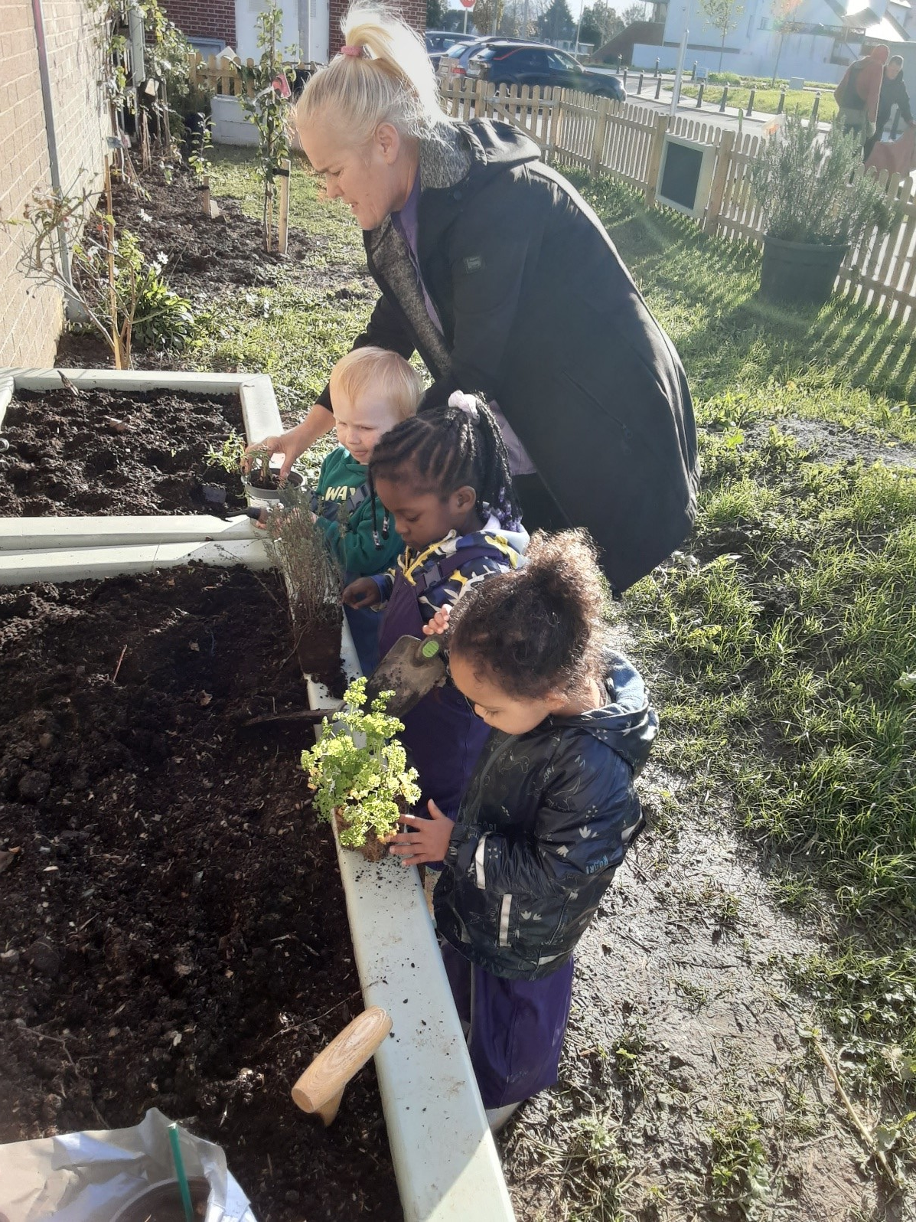
Our Introduction
Our Nursery recognises early childhood as a critical time in a person's life with enormous impacts on their future. Our Nursery has been serving the children and families of Ballymun since 1971 with a focus on prevention and early intervention to improve outcomes for children and their families.
Our ambition for 2029 is to build on our accomplishments, to continue to offer a quality service to children, support families, invest in our staff team and respond to the needs of Ballymun's growing community.
We would like to thank everybody who contributed to forming this plan, especially our children and parents, their insights and knowledge have been invaluable.

Slide 4
Our Process
The development of our strategic plan involved a series of actions and included contributions from a range of stakeholders.
The consultation and engagement took place during January – May 2024 and used a variety of methods:
A review of relevant national & international policy
A review of our policies & procedures
Consultation with children
Parent focus group and survey
Consultation with staff and management
Consultation with Board of Directors
Interviews with external stakeholders

Slide 5
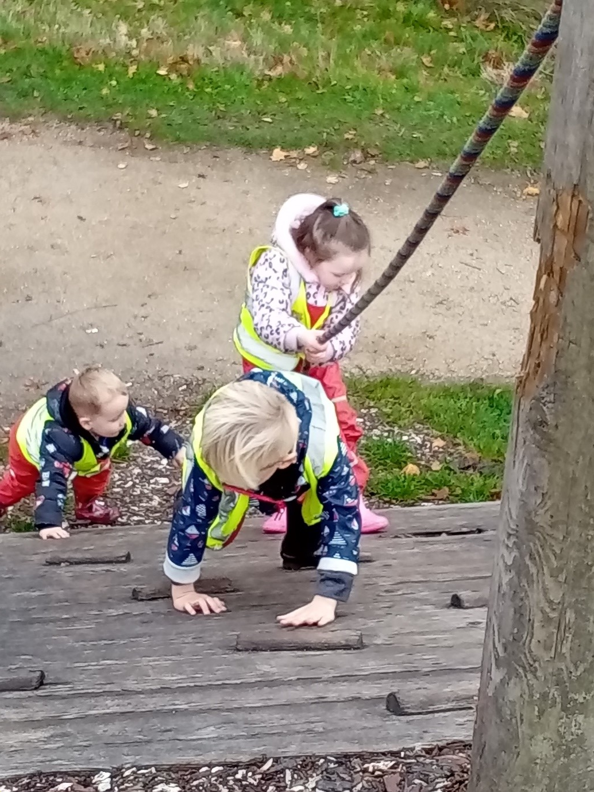
Our Vision and Mission
Our Vision
A service of the highest quality that supports children to develop their skills, knowledge and emotional resilience so that they can reach their full potential.
Our Mission
Our Nursery empowers children and their families from Ballymun and surrounding areas to reach their full potential in a safe, nurturing and inclusive early care and educational environment through early intervention and prevention approaches. We achieve this through excellence in service delivery.

Slide 6
Our Values
The uniqueness of children and their lives
The role of family in children’s lives
The community and culture of Ballymun
Our staff
The impact of early care and education for children
Collaboration with our stakeholders
The importance of continuing professional development for staff
Our Nursery's values are core to how we work and underpin how we behave with each other and the children and families we care for, as well as how we engage with our partners and within our community.
Our Nursery strategy 2024-2029

Slide 7
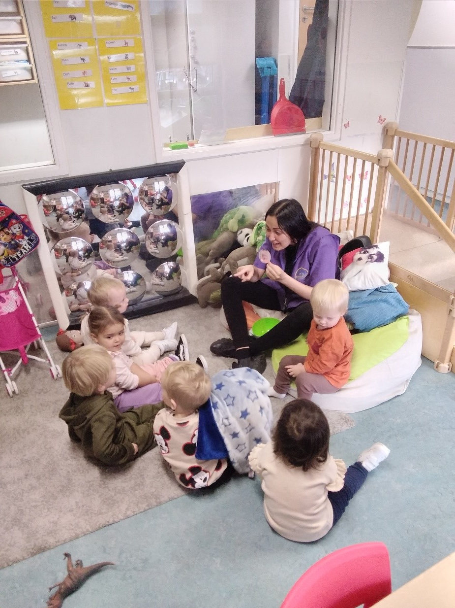

Slide 8
Overview of Our Strategic Plan
Excellence in service delivery
Build organisational capacity
Extend our premises
Strengthen governance & organisational dynamics
Our strategic plan is based on these four strategic goals:
Our Nursery strategy 2024-2029

Slide 9
1. Excellence in service delivery
Focus on the needs and rights of children through excellence in service delivery.
Strategic objectives
Children | Adhere to principles of Aistear and Síolta Empower children to have 'voice' and 'choice' Embed reflective practice Promote restorative practice Promote positive transitions for children
Parents & Families | Increase opportunities for parents to meet each other and Our Nursery team Facilitate Circle of Security Parenting programme Develop a signposting system for parents to access supports within Our Nursery Improve referral pathways for parents to access external supports Offer cooking demonstrations and provide menus to parents Support families through FEAD food programme
Stakeholders | Showcase Our Nursery through annual Open Days Develop enhanced communications systems with key stakeholders Develop a structured transition programme to support children starting primary school Strengthen two-way referral processes with key stakeholders

Slide 10
2. Build organisational capacity
Strategic objectives
Our Nursery Team (Staff, Community Employment, Students) | Meet requirements under Nurturing Skills: The Workforce Development Plan Promote an environment of continuous professional development Empower team to pursue specialist expertise to share with team members Create a learning environment for students/CE participants Strengthen support & supervision for all team Align service developments with First 5 National St
Children | Develop service to include School Age Childcare Support the development and implementation of emergent curriculums Expand the provision of Art and play therapy
Service | Work towards High Scope Curriculum accreditation Embed the principles of a Trauma Informed Approach Explore evidence-based models for school age childcare Engage in research and stay up to date with relevant ECEC national and international initiatives
Stakeholders | Build on and promote interagency collaboration Partner with third level institutions to support the needs of children
Sustainability | Secure funding sustainability for the service Become a sustainable environmentally aware service

Slide 11
3. Extend our premises
Meet the changing needs of children and families by extending our premises
Strategic objectives:
Service | Assess risks associated with expanding the building and service Assess impacts of building expansion on current service and new school age service Build a meeting space for parents Extend outdoor provision Build a space for school aged childcare provision
Stakeholders | Convene a 'Buildings' committee from within the board of directors Draw on external stakeholders with experience of building development Liaise with funders Liaise with local development authority
Funding | Conduct a feasibility study to risk assess the building plan Seek funding to extend the building Develop a project plan for the new development

Slide 12
4. Strengthen governance & organisational dynamics
Strengthen corporate governance & organisational dynamics
Strategic objectives
Legislation | Evaluate systems and process to monitor compliance with legislative requirements
Governance | Conduct a risk assessment of the service Be fully compliant with the Charities Governance Code Develop a strategy to ensure the board has required expertise (HR, Finance, Community etc.) Develop a board succession plan Provide formal support & supervision to service manager Offer induction process to new Board members Develop a Board information pack to all new Board members Conduct an annual Board review
Compliance | Develop information systems and processes to ensure easy access to information

Slide 13
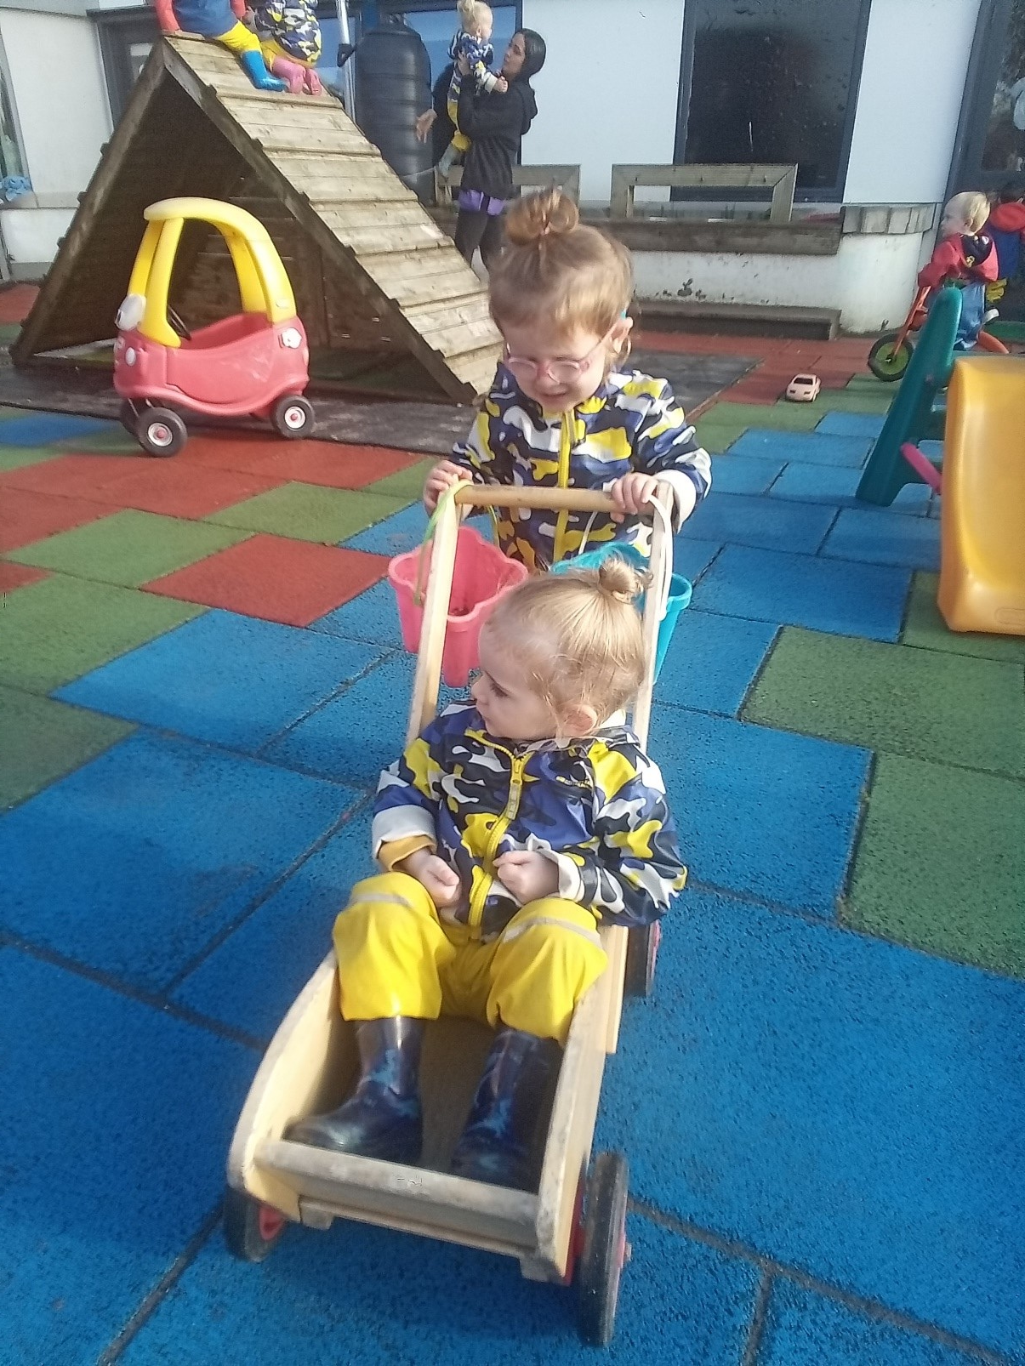
Our Implementation
The lifetime of this strategic plan is 2024 to 2029.
It provides the strategic framework for the development of implementation plans, which then informs performance objectives for our service and staff team.

Slide 14
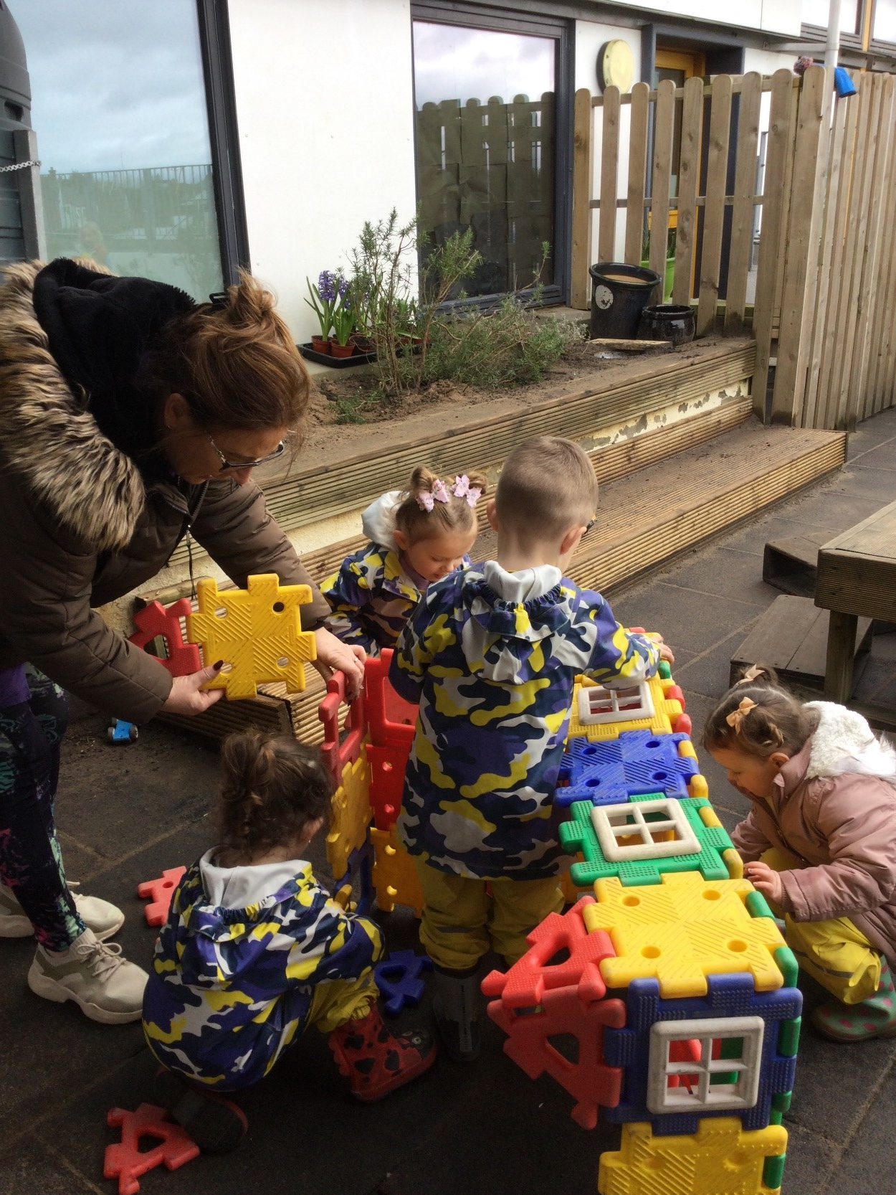

Thank You

